Slide 1

2019 Annual
Shareholders Meeting
Notes:
Ladies & Gentlemen - Good Afternoon
My Name ALG, and I want to Welcome you to our 2018 Annual Meeting of Shareholders of ENB Financial Corp. This meeting will be similar in format, as we consider the required voting action, but contemporary in its content as we provide a brief overview of our operational and fiscal activities and some comments regarding the past year, 2013 and forecasting beyond. This Corporation is the parent / HC of which the Ephrata National Bank is the wholly-owned subsidiary. I am honored to serve as President, Chief Executive Officer and Board Chairman of both entities: ENB Financial Corp and the Bank & in these capacities I will call this meeting to order.

Slide 2
Agenda
Welcome
Reading of the Minutes
Certify Voting Activity
Vote on Matters of the Proxy Statement
Discussion of Company Condition
  President’s Remarks
  Financial Review
Questions & Answers
Voting Results
Adjournment
Notes:
Today we’ve invited you here:
To conduct the business as noted on the agenda mailed to you and presented here;
Following my remarks, we will offer our traditional Financial Overview of 2013
We’ll take some time for Q & A.
We’ll consider the vote results relating to our formal agenda and;
We’ll move to adjournment.

Slide 3
Presenters
Aaron L. Groff, Jr.
  President, CEO and Board Chairman – ENB Financial Corp
  and Ephrata National Bank
Barry W. Harting
  Vice President and Corporate Secretary – ENB Financial Corp
  Senior Vice President and Chief Risk Officer – Ephrata National Bank
Notes:
Introduce our Presenters & participants:
Paul W Wenger, VP / Secretary of ENB Financial Corp & SR VP & Cashier of the Bank,
Scott Lied, Treasurer of ENB Financial Corp & Sr VP & CFO of the bank,
Barb Palm – Executive Assistant to record the discussion and actions of our meeting today and
Debbie Kerchner – Marketing Specialist-has providing Technical Assistance in building and today projecting these visual aids.
1st order of business will be to entertain a Motion to waive the reading of Minutes of the meeting of shareholders 2013 and to approve such minutes…Motion…Second… Support the motion? “I”; opposed?
To set the meeting context: On Jan 15th, 2014 our BOD adopted a resolution to support the agenda set forth in a mailing dated Apr 4th 2014. Today we have met to certify the voting activity for the items noted in the Notice of Annual Meeting & Proxy Statement and the 2nd order of business will be to ask Paul W. Wenger to:
Read Notice of Meeting,
Present the Affidavit of Mailing, and to
Ascertain whether we have a Quorum
Paul…

Slide 4
Presenters
Scott E. Lied
  Treasurer – ENB Financial Corp
  Senior Vice President and Chief Financial Officer – Ephrata National Bank
Jeffrey S. Stauffer
  Senior Vice President and Senior Lender – Ephrata National Bank
Notes:
Introduce our Presenters & participants:
Paul W Wenger, VP / Secretary of ENB Financial Corp & SR VP & Cashier of the Bank,
Scott Lied, Treasurer of ENB Financial Corp & Sr VP & CFO of the bank,
Barb Palm – Executive Assistant to record the discussion and actions of our meeting today and
Debbie Kerchner – Marketing Specialist-has providing Technical Assistance in building and today projecting these visual aids.
1st order of business will be to entertain a Motion to waive the reading of Minutes of the meeting of shareholders 2013 and to approve such minutes…Motion…Second… Support the motion? “I”; opposed?
To set the meeting context: On Jan 15th, 2014 our BOD adopted a resolution to support the agenda set forth in a mailing dated Apr 4th 2014. Today we have met to certify the voting activity for the items noted in the Notice of Annual Meeting & Proxy Statement and the 2nd order of business will be to ask Paul W. Wenger to:
Read Notice of Meeting,
Present the Affidavit of Mailing, and to
Ascertain whether we have a Quorum
Paul…

Slide 5
Meeting Certification
Presented by: Barry W. Harting
Corporate Secretary - ENB Financial Corp
Notes:
Paul…
(MEETING CERTIFICATION)
Good afternoon. I would like to announce that, on or about April 4, 2014, a Notice of this Annual Meeting of Shareholders of ENB Financial Corp was sent to shareholders of record on March 7, 2014, and that an Affidavit of Mailing executed by the Corporation’s Stock Transfer Agent, Registrar and Transfer Co., and notarized by a Notary Public in and for the State of New Jersey has been placed in the corporation’s minute book, affirming the mailing of the Notice and the associated proxy materials.
Also, according to Section 3.1 of the Corporation’s By-Laws, a majority of the outstanding shares of common stock must be represented today by votes, either in person or by proxy, to constitute a quorum for the purpose of conducting business. I can report that we have a quorum with at least 69.7% of the outstanding shares of ENB Financial Corp represented for this 2014 Annual Meeting of Shareholders.
Aaron…
You’ve heard the Meeting Certification from Paul and he will file this Meeting Notice and the Affidavit of mailing with the Minutes of this meeting and with the presence of a quorum, we can/will officially conduct the business at hand.

Slide 6
Matters of Proxy
Proxy Holders
Elect three (3) Class A directors to serve a
3-year term
Conduct a non-binding shareholder vote on executive comp
Conduct a non-binding vote on the frequency of the non-binding shareholder vote on executive comp
Ratify the selection of S.R. Snodgrass, P.C.
Transact other business
Notes:
(VOTING PROCESS 2)
Appointed as Proxy holders are: Janice S. Eaby, and John H. Shuey
Elected by the board of directors in accordance with the Bylaws of the Corporation and duly sworn in and serving as Judges of Election are: Richard H. Binner, Roger S. Kline, and William M. Rohrbach
I want to thank them for their work at today’s meeting.
At this time I will give anyone in attendance here at the annual shareholder’s meeting the opportunity to vote the shares of stock of which they were owners of record on March 7, 2014, if they have not already voted by proxy.
(Collect votes, if any, and hand them to the Judges of Election)
I will excuse the Judges of Election for the purpose of completing the “Election Report and Voting Certification” after which I will announce the official results.

Slide 7
Matters of Proxy
Elect three (3) Class A directors to serve a
3-year term
Election of Directors – Class A
Aaron L. Groff, Jr. Dr. Brian K. Reed Jeffrey S. Stauffer
Notes:
We have 1 Matter of Proxy noted here:
To elect 3 Class C directors-3 year term (All director groups by Class are noted on page 7-10 of the Proxy Statement and a photo of our Board on page 8 of the glossy.)
We have 1 Matter of Proxy noted here:
To elect 3 Class C directors-3 year term (All director groups by Class are noted on page 7-10 of the Proxy Statement and a photo of our Board on page 8 of the glossy.)
Other
Introduce Director Candidates and Full Board
(please stand when introduced)
(CLICK FOR DIRECTORS)
Class C Directors, today, when elected will begin the 1st year of a 3-year term.
Susan Y. Nicholas – An attorney and partner in the law firm, Young and Young Attorneys at Law, in Manheim. He firm offers specific legal practice in the areas of estates, trusts, & real estate.
Mark C. Wagner – Co-owner and President of White Oak Mills, Inc., located in Elizabethtown, PA. White Oak Mills, Inc. Manufactures livestock and poultry feeds and serves the agricultural communities throughout southeast PA. Additionally Mr. Wagner owns and operates several farms in Lancaster county, involved in livestock production.
Paul W. Wenger – an employee of the bank where he is currently serving as VP & Corporate Secretary of ENB Financial Corp (the Parent) of the wholly-owned subsidiary, Ephrata National Bank where he serves as Sr VP & Cashier.

Slide 8
Current Directors
Continuing Directors – Class B
Willis R. Lefever Judith A. Weaver
Continuing Directors – Class C
Joshua E. Hoffman Susan Y. Nicholas Mark C. Wagner Paul W. Wenger
Notes:
(CURRENT DIRECTORS)
Continuing Directors:
(CLICK FOR CLASS A)
Class A Directors, beginning the 2nd year of their 3 year terms are:
Aaron L. Groff, Jr.
Brian K. Reed, absent
Paul M. Zimmerman, Jr
(CLICK FOR CLASS B)
Class B Directors, beginning the 3rd year of their 3-year term are:
Willis R. (Bill) Lefever
Donald Z. Musser
Judith A. Weaver
PAUSE
Call on Paul Wenger to facilitate the Voting Process: -Judges / Proxys

Slide 9
Voting Process
Presented by: Barry W. Harting
Corporate Secretary - ENB Financial Corp
Notes:
At a Board Meeting earlier this year, on January 15th, the Board of Directors appointed 2 proxy holders and elected 3 Judges of Election to serve at today’s annual meeting of shareholders. This morning the Proxy holders and Judges of Election met to verify the votes received by proxy for today’s meeting. I would like to introduce the people that served in those positions. I invite them to please stand and be recognized.

Slide 10
Voting Process
Proxy Holders
Judges of Election
Janice S. Eaby
John H. Shuey
Paul W. Wenger
Roger S. Kline
John L. Weber
Notes:
(VOTING PROCESS 2)
Appointed as Proxy holders are: Janice S. Eaby, and John H. Shuey
Elected by the board of directors in accordance with the Bylaws of the Corporation and duly sworn in and serving as Judges of Election are: Richard H. Binner, Roger S. Kline, and William M. Rohrbach
I want to thank them for their work at today’s meeting.
At this time I will give anyone in attendance here at the annual shareholder’s meeting the opportunity to vote the shares of stock of which they were owners of record on March 7, 2014, if they have not already voted by proxy.
(Collect votes, if any, and hand them to the Judges of Election)
I will excuse the Judges of Election for the purpose of completing the “Election Report and Voting Certification” after which I will announce the official results.

Slide 11
President’s Remarks
Presented by: Aaron L. Groff, Jr.
President & CEO - ENB Financial Corp
Notes:
As I noted on the out start, this meeting/gathering is called with the primary purpose to consider the items noted on the agenda and subsequent action(s). Our nicely prepared annual report, which includes the required Form 10-K, a Securities & Exchange Commission narrative, is always the result of many people working together and it does provides a very detailed account of our fiscal movement through 2013, we will lift out some significant highlights for reflection.

Slide 12
Mission Statement
  To remain an independent community bank of undisputed integrity, serving the communities of Lancaster County and beyond.
  To offer state-of-the-art financial products and services of high quality and value at an affordable price.
  To provide unsurpassed personal service, delivered by a highly dedicated professional team.
Notes:
And I’d be remiss if I didn’t acknowledge a very integral and guiding component for all of our endeavors….our (MISSION STATEMENT)…embraced from the top by our Board of Directors and each of our more than 230 staff members. A few of the remarkable adjectives…Be-Independent & Community, Offer- Quality & Value, Provide-Unsurpassed, Dedicated & Professional

Slide 13
Vision Statement
  To help clients achieve financial success
  as defined by them
  by discovering their goals and dreams
  in order to provide helpful advice.
Notes:
And I’d be remiss if I didn’t acknowledge a very integral and guiding component for all of our endeavors….our (MISSION STATEMENT)…embraced from the top by our Board of Directors and each of our more than 230 staff members. A few of the remarkable adjectives…Be-Independent & Community, Offer- Quality & Value, Provide-Unsurpassed, Dedicated & Professional

Slide 14
2019 – 2021 Strategic Plan
Energize employees and manage succession
Improve efficiency and financial performance
Attract customers at earlier stages of financial life
Improve how we deliver the Bank to area businesses
Implement a focused shareholder relations program
Notes:
talk about charitable spirit. What we give as a percent of earnings. EITC. Scott giving numbers to Aaron.

Slide 15
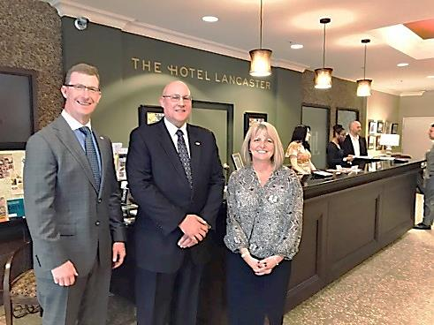
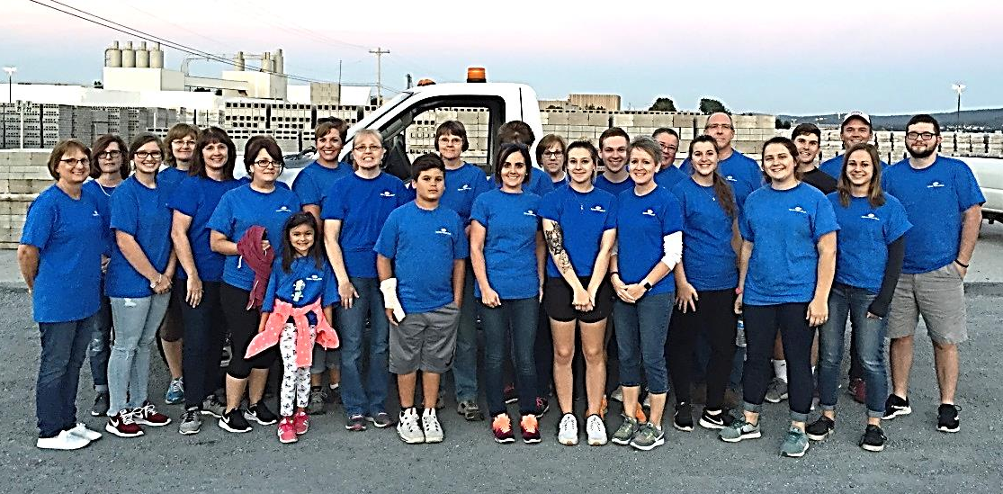
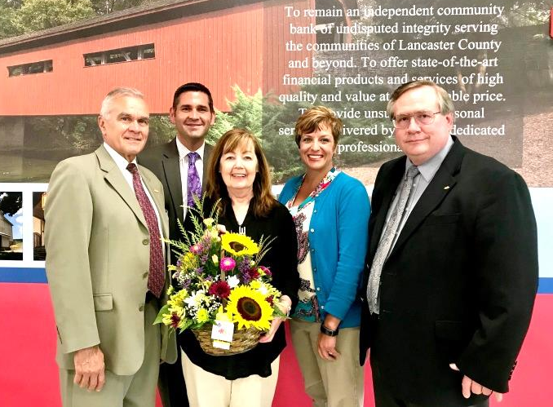
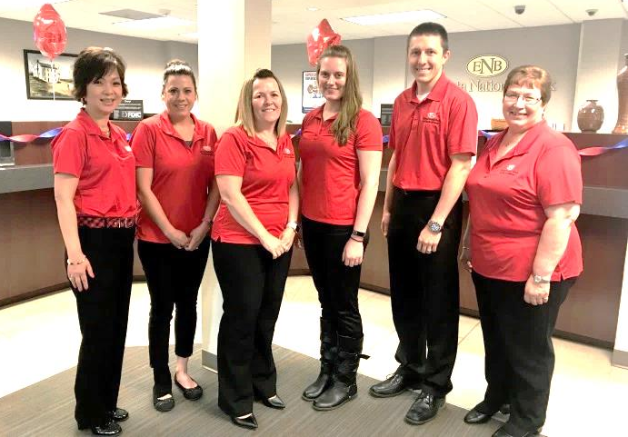
Employees
Notes:
talk about charitable spirit. What we give as a percent of earnings. EITC. Scott giving numbers to Aaron.

Slide 16
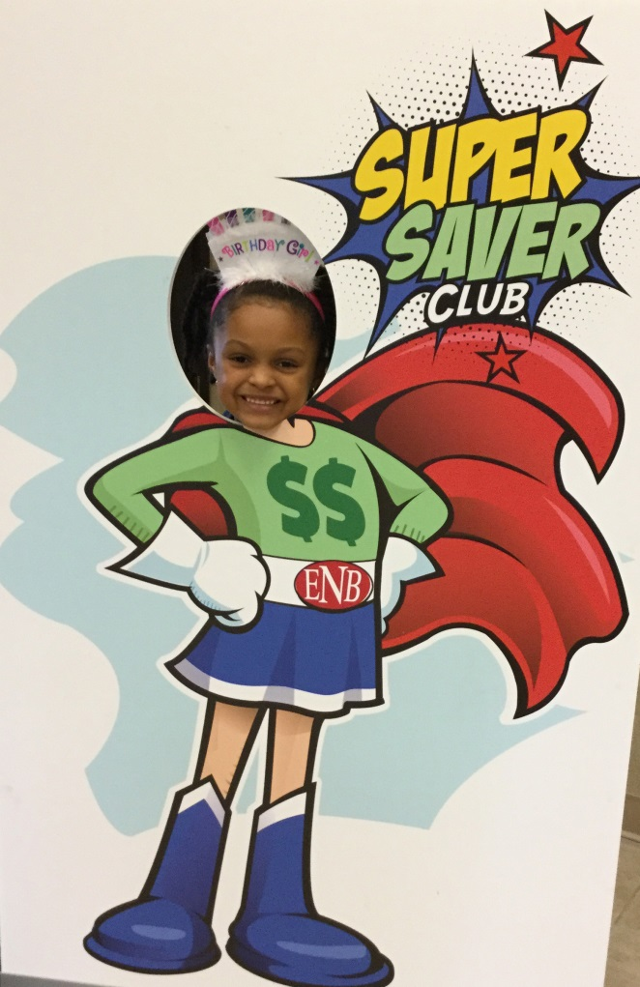
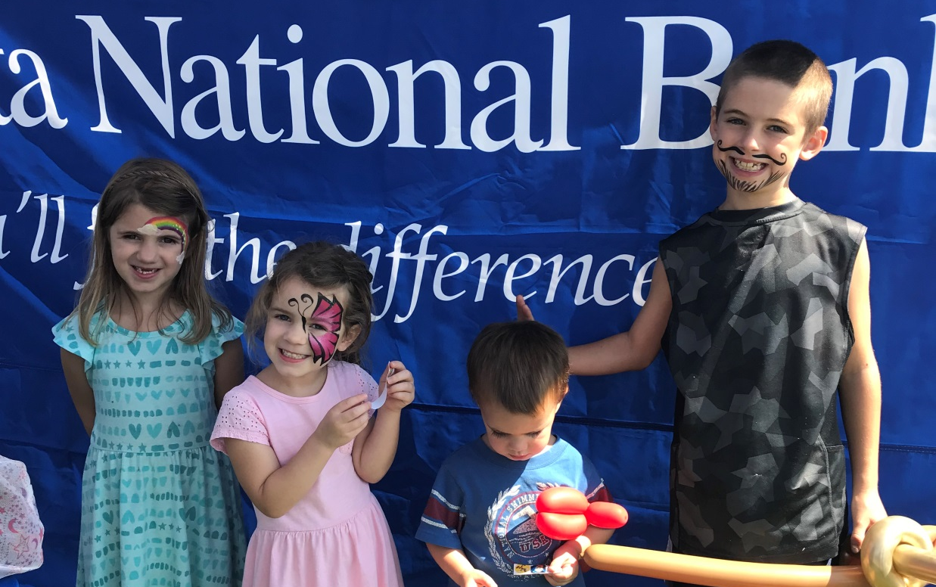
Customers
Notes:
talk about charitable spirit. What we give as a percent of earnings. EITC. Scott giving numbers to Aaron.

Slide 17
Shareholders
Maximize Efficiency
Dividend Increases
Stock Split
OTCQX Exchange
Stock Buy Back
Notes:
talk about charitable spirit. What we give as a percent of earnings. EITC. Scott giving numbers to Aaron.

Slide 18

Keeping our Customers Safe
Notes:
ENB Mortgage Expansion

Slide 19
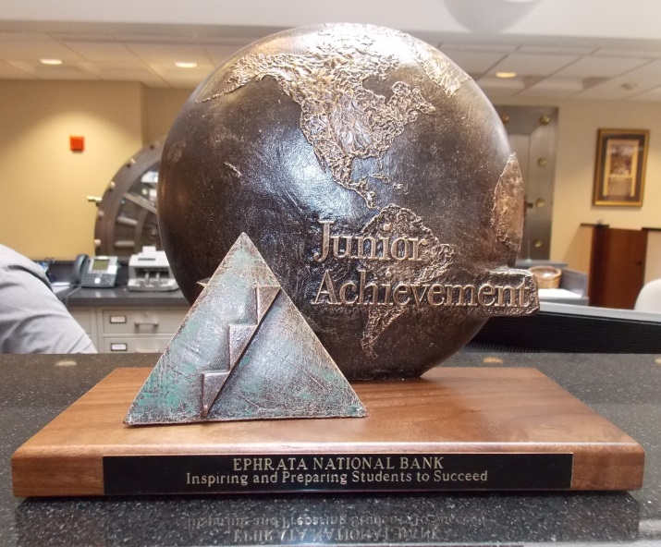
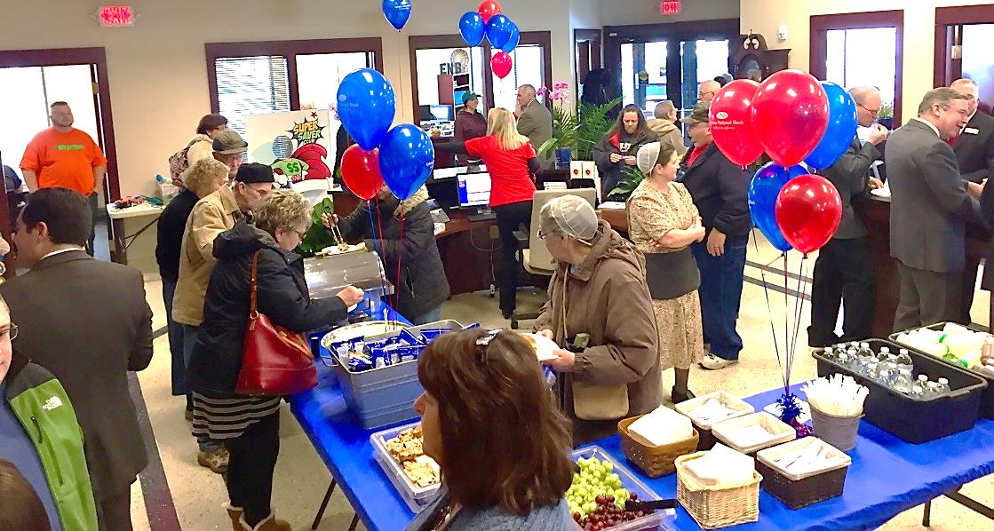
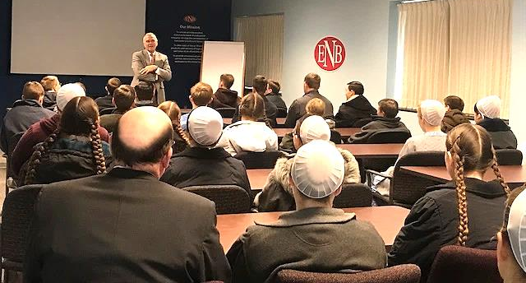
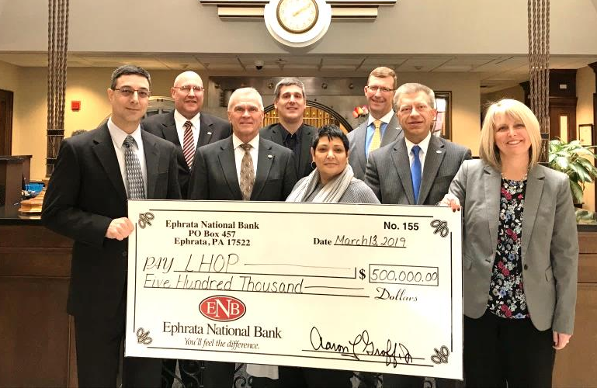
Community
Notes:
talk about charitable spirit. What we give as a percent of earnings. EITC. Scott giving numbers to Aaron.

Slide 20
Financial Results
Presented by: Scott E. Lied
Treasurer - ENB Financial Corp
Notes:
To review some of the highlights contained therein; we’ll have a (FINANCIAL REVIEW) by Scott Lied
Scott…

Slide 21
Disclosures
Unaudited Financial Information
  Some of the following slides do present financial information that is unaudited. Therefore, this information is subject to adjustments that could be necessary upon completion of the annual audit.
Forward Looking Statements
  Some of the material and/or language used in this presentation would be considered as a forward looking statement. Management is not obligated to update these forward looking statements.
Notes:
(DISCLOSURES – Slide 1)
We begin the Financial Presentation with the standard disclosure:
Some of the following slides may contain Unaudited information, such as information shared about 2014 results or projections.
This information is subject to adjustments upon completion of the 2014 Audit.
Some of the material and/or language used in this presentation would be considered a forward-looking statement. Under the safe harbor provisions, Management is not obligated to update these forward-looking statements.

Slide 22
Net Income
Dollars in Thousands
Notes:
(NET INCOME – Slide 2)
The Corporation earned $7.7 million dollars in 2013, a 0.9% increase over 2012.
2013 represented the 3nd consecutive year of record earnings, and 5th consecutive year of higher earnings.
Our financial goal is to achieve a higher earnings steam over the long term. To do this there are times when we will make investments for the future that will initially impact earnings. We have already made investments into our Branch network in 2013 and in 2014 we are making investments in our Mortgage area to drive more Mortgage volume.
2013 results, like prior years, were still highly influenced by the interest rate environment. With interest rates remaining at historically low levels, increasing net interest income has been a challenge.
However, the extremely low rates have also produced record unrealized security gains.
Asset growth rates have picked up, but continue to be limited by slow economic growth, Loan demand has improved, but many businesses are holding back expansion plans.
Asset quality remains extremely strong, allowing management to take credit provisions to reduce our ALLL.

Slide 23
Significant Items
Dollars in Thousands | 2018 $ | 2017 $ | Incr./Decr. $ | Incr./Decr.%
Net Interest Income | 33,124 | 30,178 | 2,946 | 9.8
Provision for Loan Loss | 660 | 940 | (280) | -29.8
Other Income | 11,328 | 9,646 | 1,682 | 17.4
Security Gains/(Losses) | (291) | 675 | (966) | NA
Operating Expense | 32,446 | 30,877 | 1,569 | 5.1
Pre Tax Income | 11,055 | 8,682 | 2,373 | 27.3
Notes:
(CORE EARNINGS ITEMS – Slide 3)
This slide Summarizes the 3 major components of the Income Statement
Net Interest Income – NII is our main income source, or core earnings, making up 70% of our Gross Revenue. Commonly referred to as margin income.
The Corporations NII declined in 2013 as asset yields fell faster than our cost of funds. This is typical in a prolonged low rate environment.
Due to soft loan demand we were not able to grow asset balances sufficiently to increase our top line (NII). This has improved in 2014.
Other Income – Excluding Security Gains, Other Income declined by 2.5%.
Past regulatory changes have made it more difficult to increase fee income on the Bank’s largest fees, which are Debit Card and Overdraft income.
Additionally, mortgage fee income is down due to lower levels of refinancing.
Operating Expenses – Operating expenses grew 3.6% in 2013, a moderate increase.
However, higher levels of expenses will occur in 2014 related to the two new branches brought on line during 2013.
Additionally, as we mentioned, expenses have been allocated for the expansion of our mortgage program.
These expenditures are necessary to achieve higher income streams vital to the Corporations future success.
In Summary – The net impact of these 3 core items was a reduction of $1,253,000 of Pre-tax income.

Slide 24
2018 Balance Sheet Growth
Total Assets up $64.2 million + 6.2%
Total Loans up $96.5 million + 16.2%
Total Deposits up $53.3 million + 6.1%
Total Capital up $3.0 million + 3.1%
Notes:
(LOAN GROWTH – Slide 10)
If there is one thing that is important to the growth and financial health of a Bank it is loan growth. Loan growth supports higher levels of income. Loans are our largest asset that earns the highest yield.
2013 was a good year for loan growth with nearly $24 million of new loans, a 5.8% increase. This follows 2012, a year with less than 1% loan growth.
In our local area we are seeing Agricultural lending lead the way in terms of economic recovery.
Increases in Ag loans alone, accounted for all of our 2013 loan growth.
More specifically, all of the growth from the Ag side came from real estate secured loans. 90% of the Ag lending we do is real estate secured, in the form of commercial mortgages.

Slide 25
Performance Ratios
 | 2018 % | 2017 % | 2016 %
Return on Average Assets (ROA) | 0.93 | 0.63 | 0.80
Return on Average Equity (ROE) | 9.94 | 6.46 | 7.74
Net Interest Margin | 3.46 | 3.46 | 3.12
Efficiency Ratio | 71.58 | 73.23 | 75.12
Notes:
(ENB PERFORMANCE RATIOS – Slide 6)
We now want to show how our 2013 Performance numbers compared to 2012.
The key performance ratio of ROA (Return on Assets) at 0.96% was very similar to the prior year, reflecting a very slight decrease.
ROE (Return on Equity) of 8.92% was slightly higher due to lower average equity levels, shown on the line immediately below ROE.
Our Net Interest Margin for the year averaged18 bpts less, however the last two quarters of 2013 showed quarterly margin increase. This tide is turning.
The Efficiency Ratio tells how much expense is incurred to make a dollar of revenue. This ratio is highly dependent on our NII, which had declined in 2013.
Now moving to slides that specifically address several primary Shareholder Measurements.

Slide 26
Per Share Data
 | 2018 | 2017 | 2016
Earnings Per Share | $3.42 | $2.23 | $2.65
Dividends Per Share | $1.15 | $1.12 | $1.09
Dividend Payout Ratio | 33.63% | 50.22% | 41.13%
Notes:
(PER SHARE DATA – Slide 7)
The Corporation Earned $2.70 for each share of stock in 2013, a 2 cent increase.
Meanwhile Mgmt increased the Dividend by 4 cents or 4.0%.
The Dividend Ratio was nearly the same in 2013 at 38.5% vs 37.3% in 2012.
The Board & Mgmt desires to stay with the same general Dividend Policy in 2014.
However this is dependent on continuing to increase regulatory capital levels.

Slide 27
2018 Peer Analysis
Measurement | ENBP % | PA Bank Peer* %
Return on Average Assets LTM | 0.93 | 0.96
Core Return on Average Equity | 9.9 | 9.7
Price to Earnings LTM | 10.4 | 12.5
Price to Tangible Book | 98.6 | 128.9
Dividend Yield | 3.36 | 2.93
*Data as of December 31, 2018 from Boenning & Scattergood, Inc., 1st Qtr. 2019 Mid-Atlantic Regional Bank & Thrift Review consisting of 71 publically traded PA headquartered banks.
Notes:
(PEER ANALYSIS 1 – Slide 8)
We conclude remarks on 2013 financial results by showing two slides related to Peers
While we could talk further about our own Performance, the better question is how do we stack up with our Peers? The Pennsylvania Banks. This Peer Group is from McAdams Wright Regan’s Community Bank Report. 92 Publicly traded Banks.
We have significantly outperformed in terms of ROA and ROE than the PA Peer Group, carrying ratios that are roughly 25% higher in performance.
The next two ratios reinforce that despite our better earnings, we trade at lower Price to Earnings and Price to Book multiples.
Lastly, our Dividend Yield is significantly above the PA Peer Group.
This reinforces that our Dividend Yield is already sufficient and is not a deterrent as to our stock price.

Slide 28
2018 Peer Analysis
Measurement | ENBP % | PA Bank Peer* %
Tangible Capital to Assets | 9.4 | 9.1
Tier 1 Ratio | 13.2 | 13.0
Total Capital Ratio | 14.3 | 14.3
Efficiency Ratio (Adjusted) | 73.0 | 64.7
Non-Performing Assets/Total Assets | 0.17 | 0.58
Allowance for Loan Losses | 1.25 | 1.05
*Data as of December 31, 2018 from Boenning & Scattergood, Inc., 1st Qtr. 2019 Mid-Atlantic Regional Bank & Thrift Review consisting of 71 publically traded PA Banks.
Notes:
(PEER ANALYSIS 2 – Slide 9)
This slide addresses several Balance Sheet and Asset Quality ratios.
We have had limited discussion of our Balance sheet and it is appropriate that you know that loan growth is always a primary goal.
Our Loan to Deposit Ratio of 66% remains lower than the Peer group at 78%. The new market areas we have entered are key to growing loans.
Conversely on the liability side of the Balance Sheet, we are fortunate to carry very high levels of Non-Interest Checking as a % of Deposits.
Our levels are nearly double the PA Peer Group, providing abundant low cost funding.
The Equity to Assets Ratio still holds an advantage to PA peers
And the last two ratios point to our very favorable Asset Quality numbers, with less than an eighth of the amount of Problem loans as the typical PA Bank, and even with our Credit Provisions we still have a materially larger ALLL than the typical PA Bank.

Slide 29
First Quarter 2019 Results
(Unaudited)
Earnings: $2.6 million, Down $218,000, or 7.7%.
*Adjusted for BOLI: Up $695,000, or 36.4%
ROA: 0.97%
ROE: 10.22%
Net Interest Income: Up $1.2 million, or 15.9%
Net Interest Margin: 3.59%
Mortgage Gains: $349,000 vs. $235,000
*Non-GAAP Financial Measurement
Notes:
(FIRST QUARTER 2014 RESULTS – Slide 12)
The timing of this Annual Meeting allows us to mention 1st Qtr 14 Results, which have already been released.
1st Qtr 2014 Earnings were a healthy $1.84 million, a 8.5% decline from strong 1st Qtr 2013 earnings.
ROA was a healthy 0.92%. In line with expectations for 2014
Net interest margin increased on a sequential basis increased by 1 basis point to 3.23%.
Management took $663,000 of securities gains in Q1, more than expected as the environment remained favorable to pulling gains, but still less than 1st Qtr of 13.
A $200,000 Credit Provision assisted income, coming in higher than expected.
Lastly, subsequent to 1st Qtr results...many of you are aware that effective for the 2nd Qtr Dividend Payment we increased our Dividend by a penny or 3.8% to 27 cents per share.

Slide 30
Loan Growth
Presented by: Jeffrey S. Stauffer
SVP Senior Lender – Ephrata National Bank
Notes:
To review some of the highlights contained therein; we’ll have a (FINANCIAL REVIEW) by Scott Lied
Scott…

Slide 31
Area of Focus
2018 Loan Growth
Dollars in Millions | 2018 $ | 2017 $ | Increase $ | Increase %
Commercial R/E | 285.4 | 260.8 | 24.6 | 9.4
Consumer R/E | 293.7 | 249.3 | 44.4 | 17.8
Comm & Industrial | 104.1 | 80.9 | 23.2 | 28.7
Consumer Loans | 9.2 | 5.3 | 3.9 | 73.6
Total Loans * | 692.5 | 596.3 | 96.2 | 16.1
* Net of Deferred Fees
Notes:
(CORE EARNINGS ITEMS – Slide 3)
This slide Summarizes the 3 major components of the Income Statement
Net Interest Income – NII is our main income source, or core earnings, making up 70% of our Gross Revenue. Commonly referred to as margin income.
The Corporations NII declined in 2013 as asset yields fell faster than our cost of funds. This is typical in a prolonged low rate environment.
Due to soft loan demand we were not able to grow asset balances sufficiently to increase our top line (NII). This has improved in 2014.
Other Income – Excluding Security Gains, Other Income declined by 2.5%.
Past regulatory changes have made it more difficult to increase fee income on the Bank’s largest fees, which are Debit Card and Overdraft income.
Additionally, mortgage fee income is down due to lower levels of refinancing.
Operating Expenses – Operating expenses grew 3.6% in 2013, a moderate increase.
However, higher levels of expenses will occur in 2014 related to the two new branches brought on line during 2013.
Additionally, as we mentioned, expenses have been allocated for the expansion of our mortgage program.
These expenditures are necessary to achieve higher income streams vital to the Corporations future success.
In Summary – The net impact of these 3 core items was a reduction of $1,253,000 of Pre-tax income.

Slide 32
Commercial Loan Growth
Commercial Mortgages
- Grew $11.3 million or 12.6%
- Portfolio grew to $101.4 million
Commercial & Industrial (C&I)
- Grew $19.6 million or 47.4%
- Portfolio grew to $61.0 million
Notes:
(DISCLOSURES – Slide 1)
We begin the Financial Presentation with the standard disclosure:
Some of the following slides may contain Unaudited information, such as information shared about 2014 results or projections.
This information is subject to adjustments upon completion of the 2014 Audit.
Some of the material and/or language used in this presentation would be considered a forward-looking statement. Under the safe harbor provisions, Management is not obligated to update these forward-looking statements.

Slide 33
Agricultural Loan Growth
Agricultural Mortgages
- Grew $13.9 million or 9.1%
- Portfolio grew to $165.9 million
Agricultural C & I Loans
- Grew $1.7 million or 9.1%
- Portfolio grew to $20.5 million
Ag Loans account for 26.9% of Total Loans
Notes:
(DISCLOSURES – Slide 1)
We begin the Financial Presentation with the standard disclosure:
Some of the following slides may contain Unaudited information, such as information shared about 2014 results or projections.
This information is subject to adjustments upon completion of the 2014 Audit.
Some of the material and/or language used in this presentation would be considered a forward-looking statement. Under the safe harbor provisions, Management is not obligated to update these forward-looking statements.

Slide 34
Residential Loan Growth
1 – 4 Family Residential Mortgages
- Grew $42.1 million or 23.8%
- Portfolio grew to $219 million
Home Equity Lines of Credit
- Grew $3.3 million or 5.4%
- Portfolio grew to $64.4 million
Notes:
(DISCLOSURES – Slide 1)
We begin the Financial Presentation with the standard disclosure:
Some of the following slides may contain Unaudited information, such as information shared about 2014 results or projections.
This information is subject to adjustments upon completion of the 2014 Audit.
Some of the material and/or language used in this presentation would be considered a forward-looking statement. Under the safe harbor provisions, Management is not obligated to update these forward-looking statements.

Slide 35
Voting Results
Presented by: Barry W. Harting
Corporate Secretary - ENB Financial Corp
Notes:
(Voting Results)
The Judges of Election have completed the “Election Report” and certified the following results:
At the close of business on March 7, 2014, the date of record for this year’s shareholder’s meeting, the outstanding stock of the Corporation that was entitled to vote was 2,851,209 shares.
The holders of 1,987,329 shares of common stock, or 69.7% of the outstanding shares, are represented today by proxy and in person.
The results of the voting are as follows:
Concerning the election of each of the three nominees for Class C director to serve for a three-year term: Each nominee received a favorable vote of at least a 99.5% of votes cast, and are hereby elected.
These certified election results will be entered into the records of the Corporation and reported to the appropriate banking and governing authorities. This completes the voting process for this 2014 Annual Meeting of Shareholders.

Slide 36
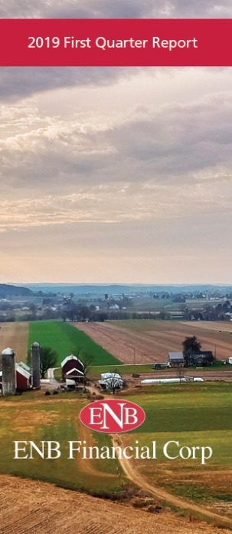
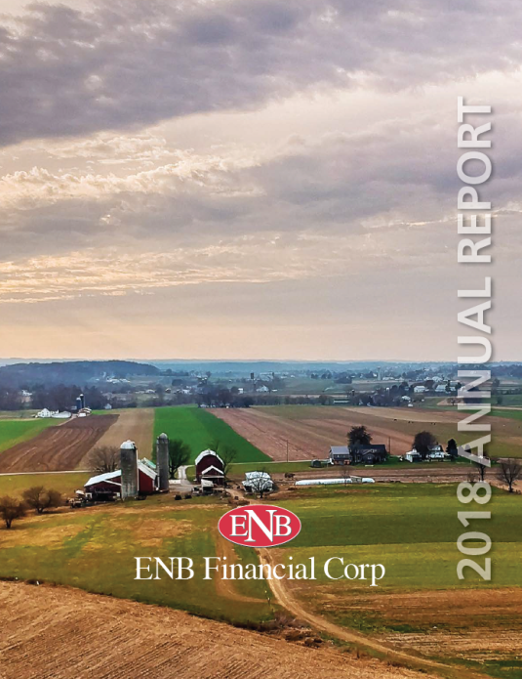
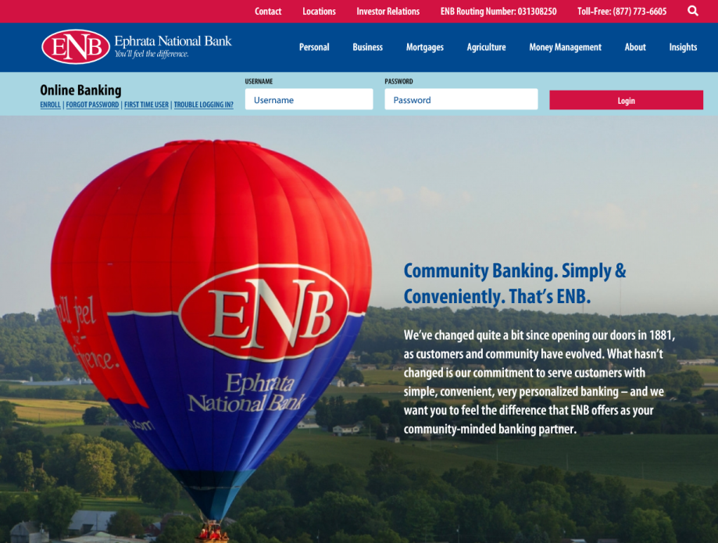





Communication
Notes:
Aaron…
(Q & A): State name

Slide 37
2019 Annual
Shareholders Meeting
Notes:
Ladies & Gentlemen - Good Afternoon
My Name ALG, and I want to Welcome you to our 2018 Annual Meeting of Shareholders of ENB Financial Corp. This meeting will be similar in format, as we consider the required voting action, but contemporary in its content as we provide a brief overview of our operational and fiscal activities and some comments regarding the past year, 2013 and forecasting beyond. This Corporation is the parent / HC of which the Ephrata National Bank is the wholly-owned subsidiary. I am honored to serve as President, Chief Executive Officer and Board Chairman of both entities: ENB Financial Corp and the Bank & in these capacities I will call this meeting to order.

