Slide 1


Slide 2
Agenda
Welcome
Reading of the Minutes
Certify Voting Activity
Vote on Matters of the Proxy Statement
Discussion of Company Condition
  President’s Remarks
  Financial Review
Questions & Answers
Voting Results
Adjournment

Slide 3
Presenters
Jeffrey S. Stauffer
  President and CEO – ENB Financial Corp and Ephrata National Bank
Barry W. Harting
  Vice President and Corporate Secretary – ENB Financial Corp
  Senior Vice President and Chief Risk Officer – Ephrata National Bank
Scott E. Lied
  Treasurer – ENB Financial Corp
  Senior Vice President and Chief Financial Officer – Ephrata National Bank

Slide 4
Meeting Certification
Presented by: Barry W. Harting
Corporate Secretary - ENB Financial Corp

Slide 5
Matters of Proxy
Elect three (3) Class C directors to serve a
3-year term
Ratify the selection of S.R. Snodgrass, P.C.
Transact other business

Slide 6
Matters of Proxy
Elect three (3) Class C directors to serve a
3-year term
Election of Directors – Class C
Joshua E. Hoffman Susan Y. Nicholas Mark C. Wagner

Slide 7
Current Directors
Continuing Directors – Class B
Willis R. Lefever Jay S. Martin Judith A. Weaver
Continuing Directors – Class A
Aaron L. Groff, Jr. Dr. Brian K. Reed Jeffrey S. Stauffer

Slide 8
Voting Process
Presented by: Barry W. Harting
Corporate Secretary - ENB Financial Corp

Slide 9
Voting Process
Proxy Holders
Judges of Election
Janice S. Eaby
John H. Shuey
Paul W. Wenger
Roger S. Kline
John L. Weber

Slide 10
President’s Remarks
Presented by: Jeffrey S. Stauffer
President & CEO - ENB Financial Corp

Slide 11

Goodbye to Paul Wenger

Slide 12

Retirement of Aaron L. Groff, Jr.
  Thank you
  for 52-years of service

Slide 13
Mission Statement
  To remain an independent community bank of undisputed integrity, serving the communities of Lancaster County and beyond.
  To offer state-of-the-art financial products and services of high quality and value at an affordable price.
  To provide unsurpassed personal service, delivered by a highly dedicated professional team.

Slide 14
Vision Statement
  To help clients achieve financial success
  as defined by them
  by discovering their goals and dreams
  in order to provide helpful advice.

Slide 15

A Strategic Path Forward

Slide 16
A Strategic Path Forward
Financial Perspective
Financial growth and result
Key Financial parameters and performance (ROE, ROCE)
Higher Profit Margin
Improved Cash Flow
Lower Bad Loans and Lower Debt
Net Interest Margin
Reduced Overhead Expense
Proper Revenue Mix
Learning and Growth
Develop Critical Skills and Knowledge
Proper Knowledge Management
Provide Strategic Information to All
Align Personal Goals with Company Goals
Employee Growth and Turnover
Employee Satisfaction and Retention
Balanced
Scorecard
Customers
Increase Customer Satisfaction
Increase Customer Loyalty
Retention of Key Customers
Sales Revenue Per Customer
Competitive Pricing and Product Offering
High Quality Service
Customer Preference Compared to Competitors
Internal Business Processes
Cross-sell Products
Improve Operational Efficiency and Minimize Problems
Proper Customer Relationship Management
Higher Success Rate in Converting Business Opportunities
Fast Business Decisions and Approvals
Proper Work Culture and Higher Employee Confidence

Slide 17


A Strategic Path Forward
Attracting the Next
Generation of Customers

Slide 18
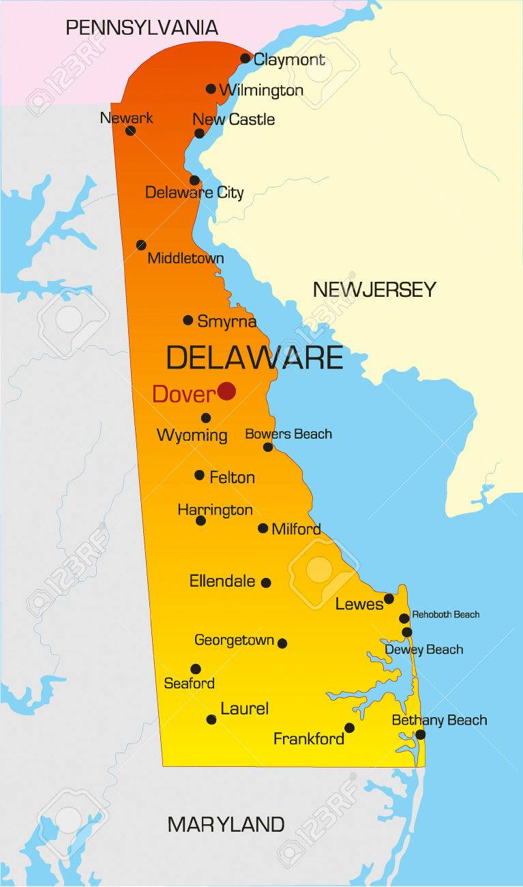
New Markets & Opportunities
Mortgage Lending Area
Expansion

Slide 19

New Markets & Opportunities
ENB Money Management Group Acquired Additional Trust Assets

Slide 20

Maintaining Customer Safety

Slide 21


Commitment to Customer Service

Slide 22
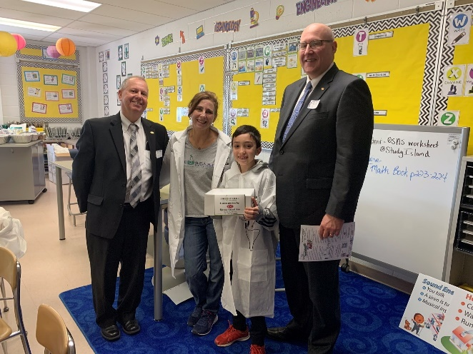
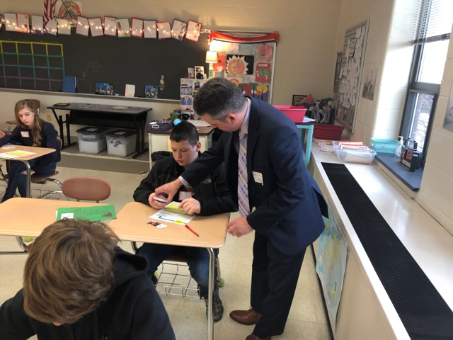
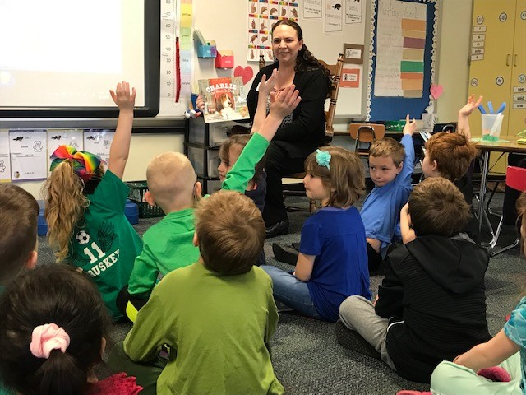
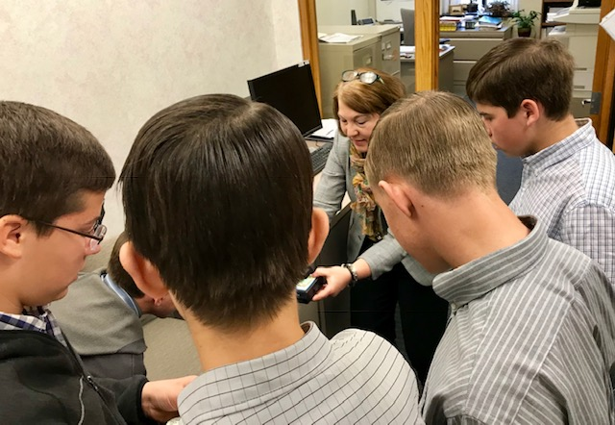
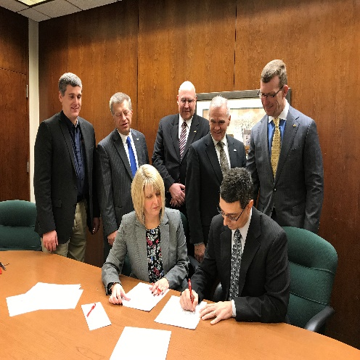
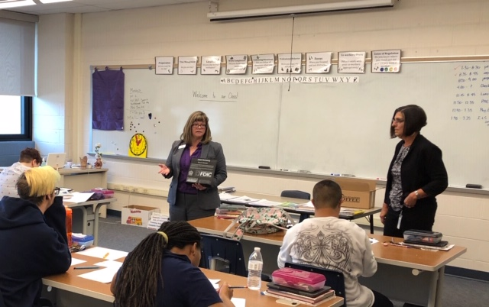
Making a Difference

Slide 23

Employee Engagement

Slide 24
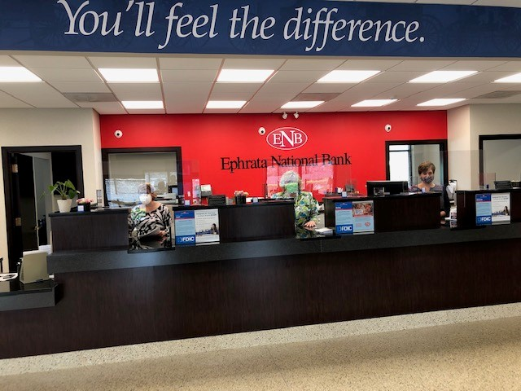
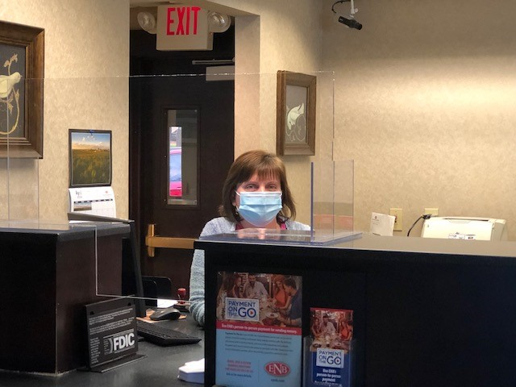
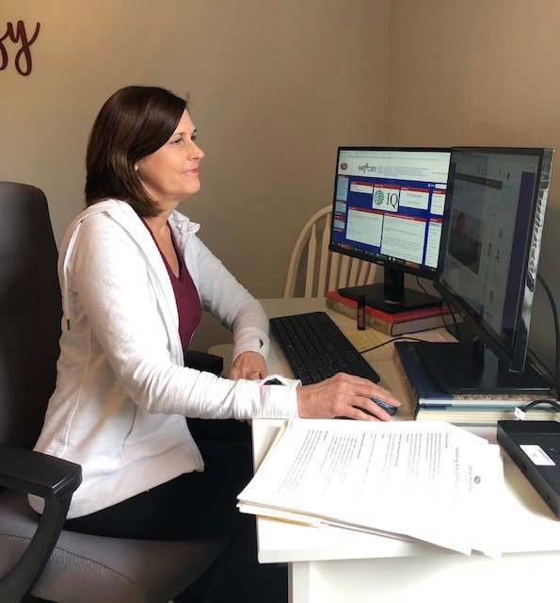
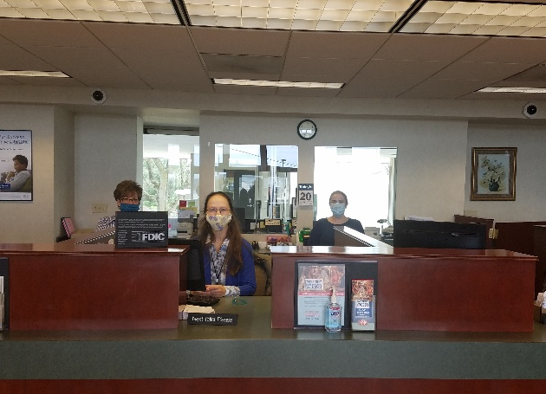
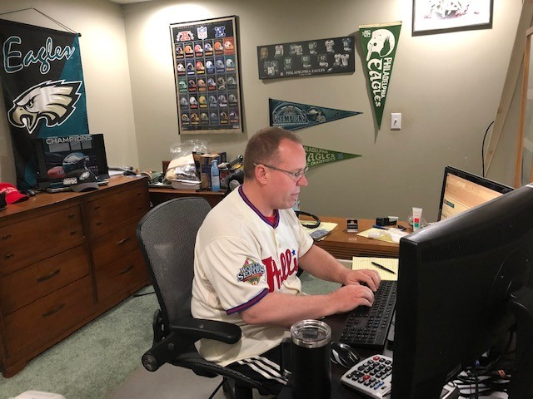
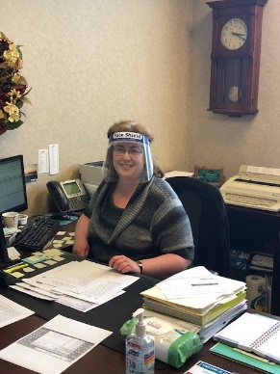

COVID-19 Response

Slide 25
Financial Results
Presented by: Scott E. Lied
Treasurer - ENB Financial Corp

Slide 26
Disclosures
Unaudited Financial Information
  Some of the following slides do present financial information that is unaudited. Therefore, this information is subject to adjustments that could be necessary upon completion of the annual audit.
Forward Looking Statements
  Some of the material and/or language used in this presentation would be considered as a forward looking statement. Management is not obligated to update these forward looking statements.

Slide 27
Net Income
Dollars in Thousands

Slide 28
Significant Items
Dollars in Thousands | 2019 $ | 2018 $ | Incr./Decr. $ | Incr./Decr.%
Net Interest Income | 36,618 | 33,124 | 3,494 | 10.5
Provision for Loan Loss | 770 | 660 | 110 | 16.7
Other Income | 10,076 | 9,690 | 386 | 4.0
Bank Owned Life Ins. | 731 | 1,638 | (907) | -55.4
Security Gains/(Losses) | 499 | (291) | 790 | NA
Operating Expense | 33,633 | 32,446 | 1,187 | 3.7
Pre Tax Income | 13,521 | 11,055 | 2,466 | 22.3

Slide 29
2019 Balance Sheet Growth
Total Assets up $73.9 million + 6.7%
Total Loans up $59.5 million + 8.6%
Total Deposits up $54.4 million + 5.9%
Total Capital up $13.9 million +13.5%

Slide 30
Performance Ratios
 | 2019 % | 2018 % | 2017 %
Return on Average Assets (ROA) | 1.01 | 0.93 | 0.63
Return on Average Equity (ROE) | 10.36 | 9.94 | 6.46
Net Interest Margin | 3.53 | 3.46 | 3.46
Efficiency Ratio | 69.82 | 71.58 | 73.23

Slide 31
Per Share Data
 | 2019 | 2018 | 2017
Earnings Per Share | $2.010 | $1.710 | $1.120
Dividends Per Share | $0.620 | $0.575 | $0.560
Dividend Payout Ratio | 30.85% | 33.63% | 50.22%

Slide 32
2019 Peer Analysis
Measurement | ENBP % | PA Bank Peer* %
Return on Average Assets LTM | 1.01 | 1.01
Core Return on Average Equity | 10.36 | 9.82
Price to Earnings LTM | 9.20 | 9.60
Price to Tangible Book | 0.89 | 0.99
Dividend Yield | 3.08 | 2.73
*Data as of December 31, 2019 from Boenning & Scattergood, Inc., 1st Qtr. 2020 Mid-Atlantic Regional Bank & Thrift Review consisting of 70 publically traded PA headquartered banks.

Slide 33
2019 Peer Analysis
Measurement | ENBP % | PA Bank Peer* %
Tangible Capital to Assets | 10.0 | 9.7
Tier 1 Ratio | 13.4 | 12.8
Total Capital Ratio | 14.5 | 14.5
Efficiency Ratio (Adjusted) | 69.8 | 64.5
Non-Performing Assets/Total Assets | 0.34 | 0.57
Allowance for Loan Losses | 1.25 | 1.04
*Data as of December 31, 2019 from Boenning & Scattergood, Inc., 1st Qtr. 2020 Mid-Atlantic Regional Bank & Thrift Review consisting of 70 publically traded PA Banks.

Slide 34
First Quarter 2020 Results
(Unaudited)
Earnings: $2.165 million, Down $438,000, or 16.9%.
- COVID-19 Impacts to MSA’s, Provision, and NII
- Higher Operating Expenses
ROA: 0.74%
ROE: 7.42%
Net Interest Income: Up $233,000, or 2.6%
Net Interest Margin: 3.41%
Mortgage Gains: $541,000 vs. $349,000

Slide 35
Voting Results
Presented by: Barry W. Harting
Corporate Secretary - ENB Financial Corp

Slide 36
Questions & Answers
Notes:
Aaron…
(Q & A): State name

